Slide 1
Shekar: A Python library for Persian NLP An Open-Source Toolkit for Processing and Understanding Persian Language Data
Presented by Ahmad Amirivojdan
CS540 – Advanced Software Engineering
Spring 2025

Slide 2
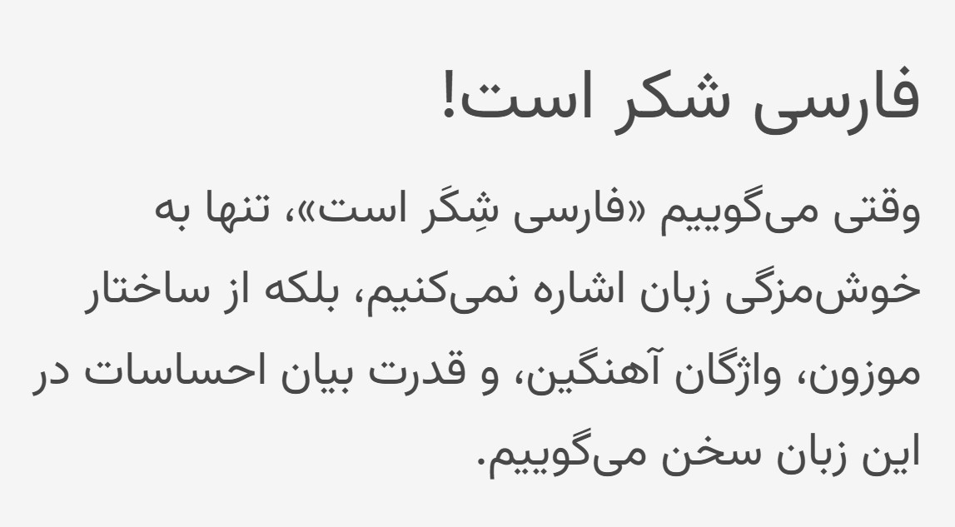
Introduction
Despite being spoken by over 100 million people in Iran, Tajikstan, and Afghanstan, Uzbekistan, Persian remains underrepresented in the NLP ecosystem.
Challenges in Persian NLP
Lack of standard processing
Lack of high-quality annotated corpora
Multiple Unicode representations
Space does not always separate words
Zero-width non-joiner complicates segmentation
Formal vs Informal Language

Slide 3
Prior Works
Existing Libraries:
Hazm – Basic NLP pipeline but limited extensibility and outdated models
DadmaTools – Richer toolset but lacks standardization and modern embeddings
Limitations in Prior Work:
Not modular and customizable
Poor support for colloquial Persian
Limited use of large-scale modern corpora like Telegram or Naab
Minimal documentation and sparse community support

Slide 4
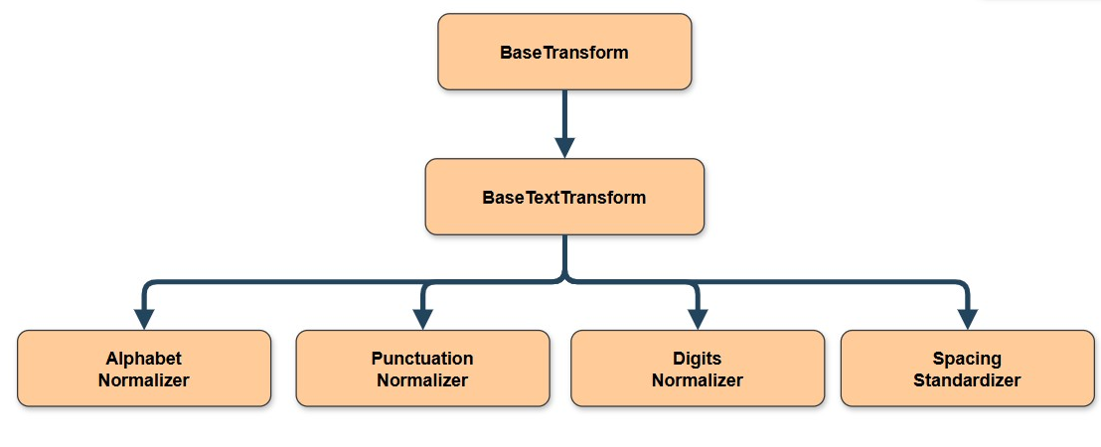
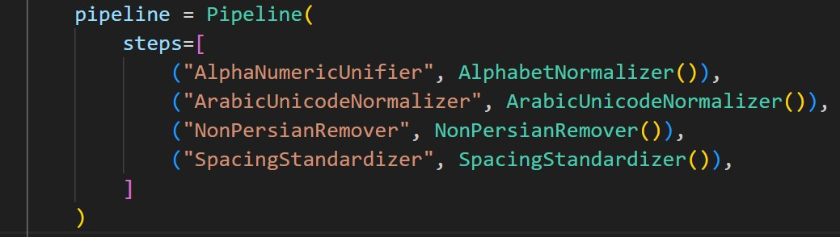
Normalizer
AlphabetNormalizer
ArabicUnicodeNormalizer
NumericNormalizer
PunctuationNormalizer
PunctuationRemover
DiacriticsRemover
RedundantCharacterRemover
NonPersianRemover
StopwordRemover
SpacingStandardizer

Slide 5
Experimental Comparison
 | Tweeter (87mb) | BCC News (145mb) | Persepolis Fanclub (58mb)
Hazm | 191s | 165s | 187s
Dadmatools | 31s | 39s | 32s
Shekar | 29s | 38s | 45s

Slide 6
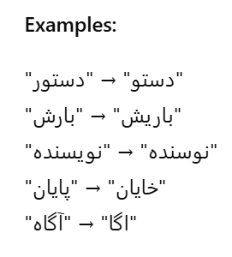
Statistical Spell Checker
Key Technique
Corpus = Wikipedia + PersianBlog + Telegram Channels
Pre-compiled normalized dictionary for fast lookups
Generate all candidate words within n edits (insertion, deletion, substitution)
Filter candidates by existence in dictionary
Rank candidates by:
Unigram frequency
Minimum edit operations

Slide 7


Embeddings
Model | Dimensions | Dataset | Intrinsic Evaluation (Clustering Acc)
FastText CBOW | 100 | Persian Blogs (600 mb) | 0.82
FastText CBOW | 300 | Naab (130 gb) | 0.80
BERT-Base | 768 | Persian Blogs | 0.70

Slide 8
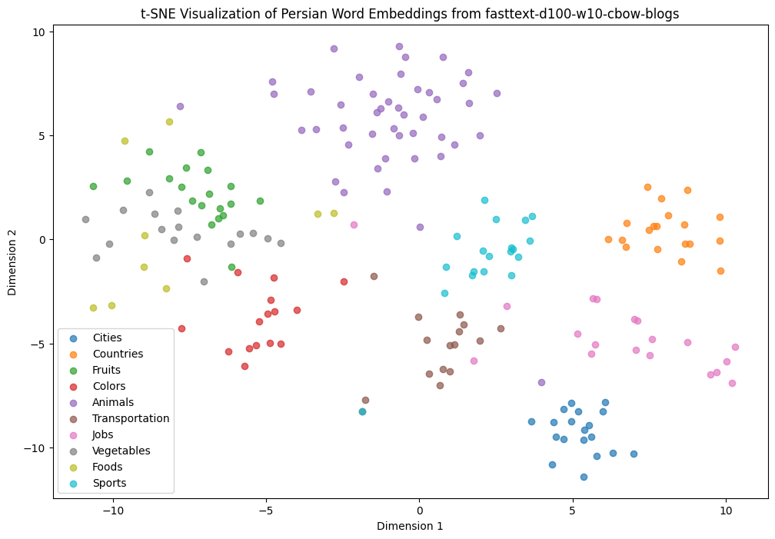
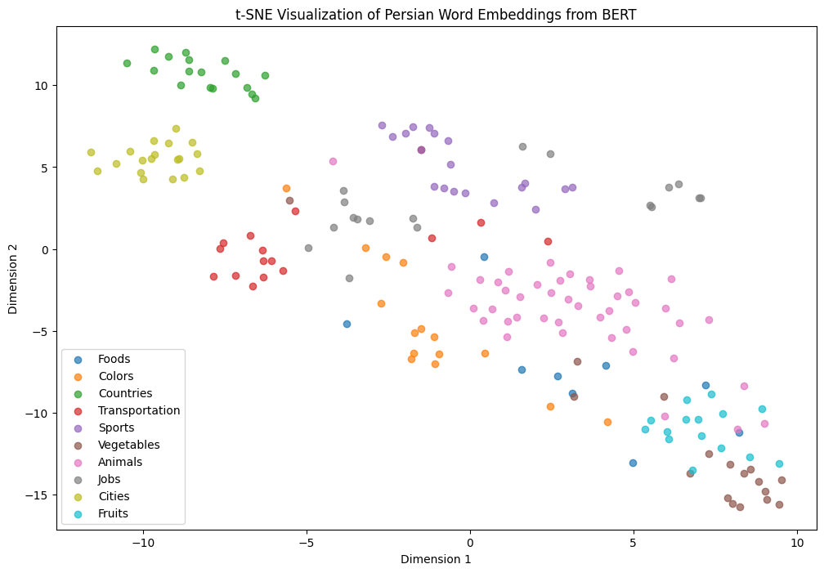
Embeddings
FastText Embeddings - 100D
BERT Embeddings - 756D

Slide 9
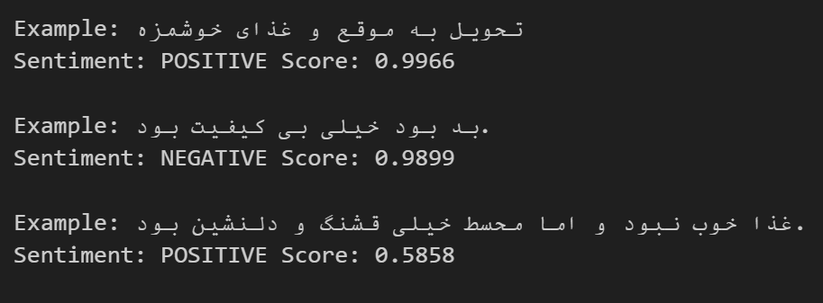
Sentiment Analysis
Epoch | Training Loss | Validation Loss | Accuracy
1 | 0.389300 | 0.311553 | 0.868286
2 | 0.287200 | 0.300371 | 0.876857
3 | 0.255100 | 0.316058 | 0.873000
SnapFood sentiment dataset
Accuracy : 0.87
Loss: 0.31

Slide 10
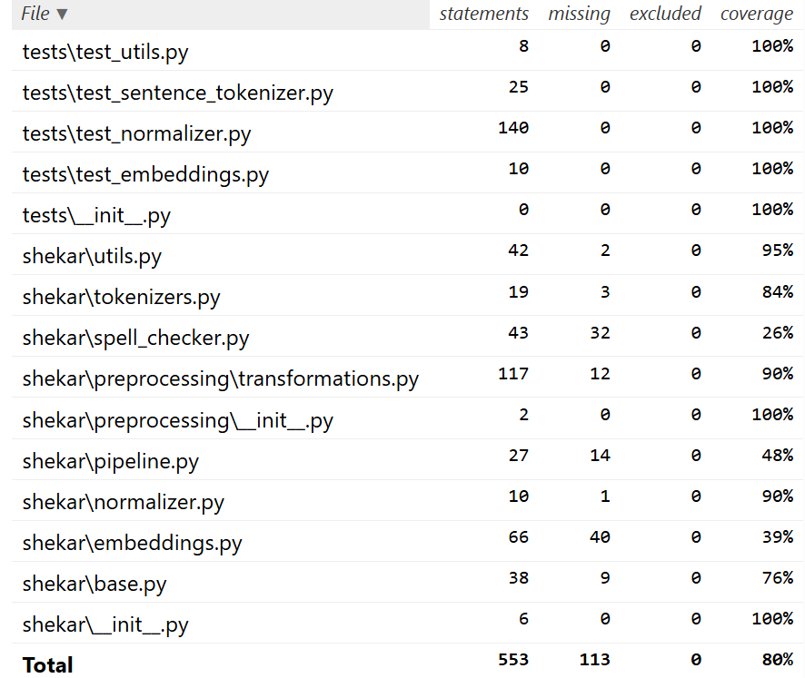
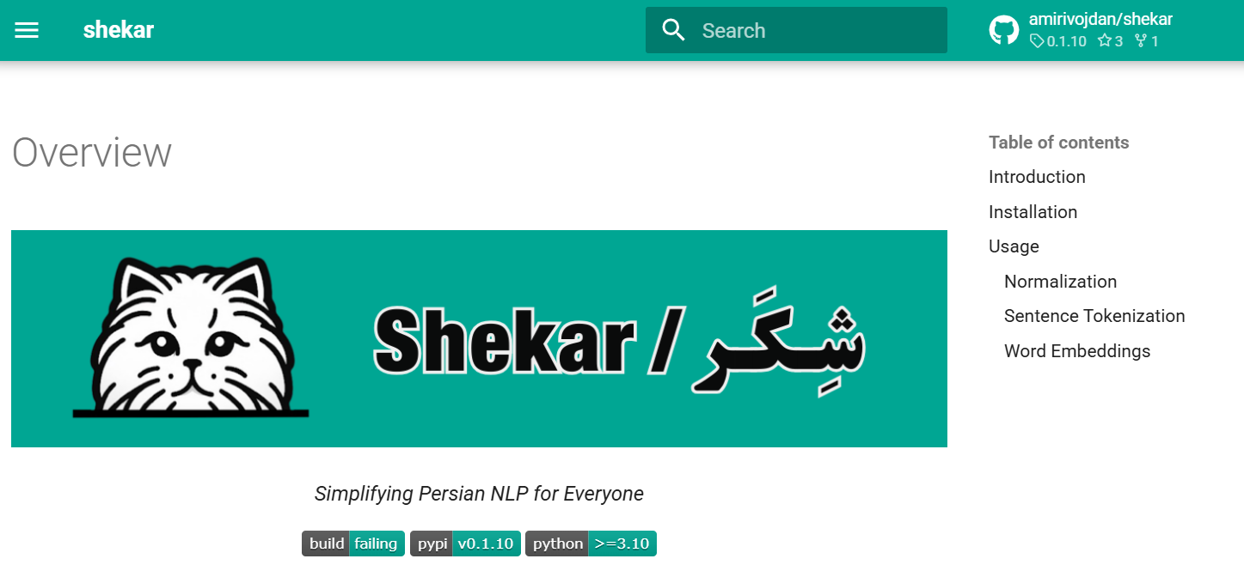
Testing & Documentation
Over 100 test cases resulting in %80 coverage
Documents available at https://lib.shekar.io/ (served on cloudflare pages)

Slide 11
Future Works
Pretraning SOTAmodels like ModernBert
POS Tagger (BERT-based)
Context-aware tagging
Handles ambiguous cases and informal language
Named Entity Recognition (NER)
Detect and classify entities like names, locations, dates
Crucial for information extraction and QA

Slide 12
Questions?

